Slide 1
CYBERMINER SOFTWARE SYSTEM
CS/SE 6362 - ADVANCED SOFTWARE ARCHITECTURE AND DESIGN
FALL 2015
Notes:
team is to architect a simple KWIC software system and implement it, which later will be used for a web search engine
Task is to build a contextualized index for the text

Slide 2
TEAM -QUICK $EARCH
Sruthi Chappidi
Barbara Maweu
Maryellen Oltman
Twinkle Sharma

Slide 3
TABLE OF CONTENTS
PURPOSE
PROBLEM STATEMENT
SPECIFICATIONS
FUNCTIONAL REQUIREMENTS
NON-FUNCTIONAL REQUIREMENTS
DESIGN
ARCHITECTURAL DESIGN
IMPLEMENTATION
TEST PLAN
DEMO

Slide 4
PURPOSE
The purpose of our project is:
Develop Cyberminer
Shall accept a list of keywords and return a list of URLs whose descriptions contain any of given keywords.
To achieve this, we are using KWIC system that we developed during phase 1.
Java Applet / J2EE
Utilizing Object Oriented Software Architecture(ADT)
Produce a system that provides a convenient search mechanism for a list of lines, such as book titles, or online documentation entries.

Slide 5
PROBLEM STATEMENT
The problem of | Not having an indexed search engine system that outputs relevant search results from user search strings (a query)
affects | people interested in searching for online links, documents or resources
the impact of which is | fast access to indexed online resources
A successful solution will be | developing Cyberminer a web application that utilizes the KWIC indexing system
Notes:
•Cyber miner shall accept a list of keywords and return a list of URLs whose descriptions contain any of given keywords.
•To achieve this, we are using KWIC system that we developed during phase 1.

Slide 6
FUNCTIONAL REQUIREMENTS
FR1.0 – The Cyberminer web search engine shall accept a list of keywords as input.
FR1.1 – The Cyberminer shall detect and correct typographical errors in the user input (Autofill).
FR2.0 – The Cyberminer web search engine shall return a list of URLs whose descriptions contain the keywords.
FR2.1 – The Cyberminer shall allow the user to click on the resulting URL(s) to be taken to the corresponding website (hyperlink enforcement).
FR2.2 – The Cyberminer shall filter out noise symbols (which are not considered meaningful) from the search.
FR2.3 – The Cyberminer will allow the user to specify an OR, AND, or NOT search.
FR2.4 – The Cyberminer will allow the user to specify case-sensitive or case-insensitive search.

Slide 7
FUNCTIONAL REQUIREMENTS, CONT’D
FR2.5 – The Cyberminer shall allow the user to specify the number of results per page.
FR2.5.1 – The Cyberminer shall allow the user to navigate between pages.
FR2.6 – The Cyberminer will allow the user to specify the listing order of the query results in ascending alphabetical order, or most-frequently-accessed order.
FR2.6.1 – The Cyberminer will allow the user to specify the listing order in a per-payment fashion.
FR3.0 – The Cyberminer shall allow the user to report broken (out-of-date) URLs.
FR4.0 – The Cyberminer shall allow multiple search engines to run concurrently.

Slide 8
NON-FUNCTIONAL REQUIREMENTS
NFR1.0 – UNDERSTANDABILITY: The system shall use icons and descriptions that are naturally understandable by the intended users.
NFR2.0 – PORTABILITY: The system shall run on Internet Explorer, Chrome and Mozilla browser.
NFR3.0 – ENHANCEABILITY: The system shall support ability to easily enhanceable by adding new modules or functions.
NFR4.0 – REUSABILITY: The system modules could be used as sub modules for other complicated systems.
NFR5.0 – PERFORMANCE: The system shall support concurrent searches.
NFR6.0 – EASE OF USE: The system shall promptly accept inputs and respond to search requests.

Slide 9
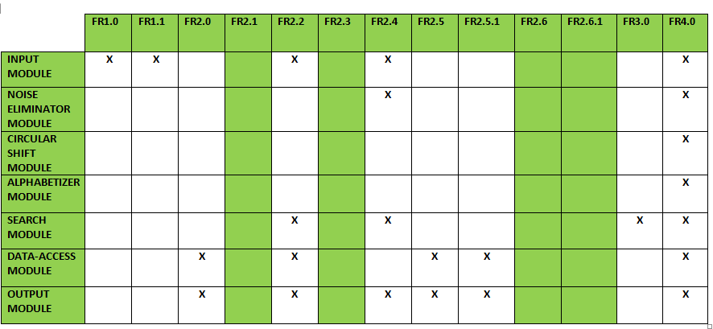
TRACEABILITY

Slide 10
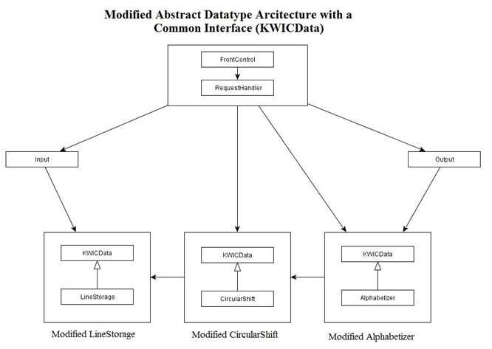
ARCHITECTURAL DESIGN
ABSTRACT DATA TYPE MODEL(ADT)

Slide 11
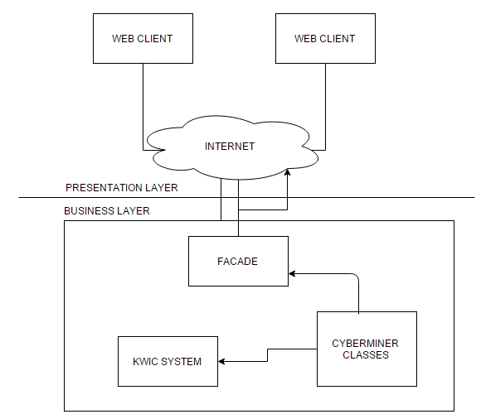
DESIGN PATTERN

Slide 12
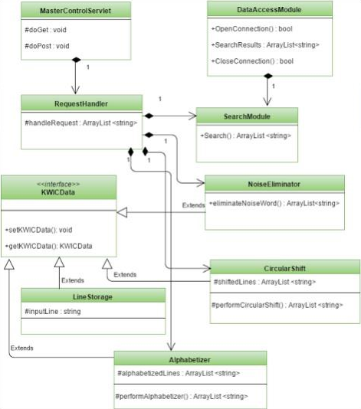
CYBERMINER CLASS DIAGRAM

Slide 13
CLASS DIAGRAM DESCRIPTION
There are 9 classes namely- MasterControl, RequestHandler, KWICData, LineStorage, CircularShift, Noise Eliminator, SearchModule, Alphabetizer, DataAccessModule
MasterControl handles the sequence between 5 other modules. It delegates the request to RequestHandler sub-module. It also handles the request received from Front Controller and sequences the processing of data by deciding which module to instantiate.
Next is the RequestHandler which passes on the input to other modules and handles requests.
The KWICData module is responsible for setting and getting the KWICData for modules like LineStorage, CircularShift, Alphabetizer and NoiseEliminator.
Line Storage creates, accesses and possibly deletes characters, words or lines.
CircularShift creates (virtual) lines of the circular shifts of the stored lines.
Alphabetizer creates alphabetized lines of the circular shift lines.
NoiseEliminator removes words like A, an, the, of, for, and etc.
SearchModule helps in the main functionality of searching the database for the string that the user has requested for. DataAccessModule returns the data requested by the search module.

Slide 14
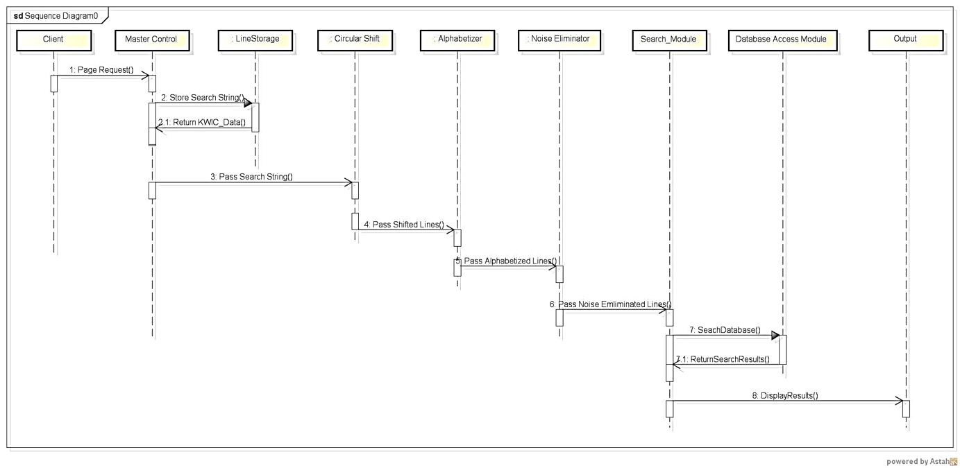
SEQUENCE DIAGRAM

Slide 15
ARCHITECTURAL RATIONALE
Abstraction and Encapsulation – ADT
Implementation of Interface
Advantages of ADT
Reusability
Portability
Robustness
Maintainability
Advantages of UML
Understandability

Slide 16
TEST PLAN
The scope of the test cases is to validate the functionality of the system features and verification of the system’s quality attributes. To achieve this scope, the category of test cases are detailed as follows.
BLACK BOX TESTS:
Derived from the functional requirements which were elicited during requirement analysis phase and are documented in the Requirement Specification document.
Derived from the non-functional requirements are documented in the Requirement Specification document.
INTEGRATION TESTS:
Derived from Cyberminer architectural design documented in the Software Architecture document.

Slide 17
IMPLEMENTATION
Java Applet / J2EE
Web application
Internet Access
Application:
example input:
Url with description to perform KWIC Indexing
Search using keywords or query

Slide 18
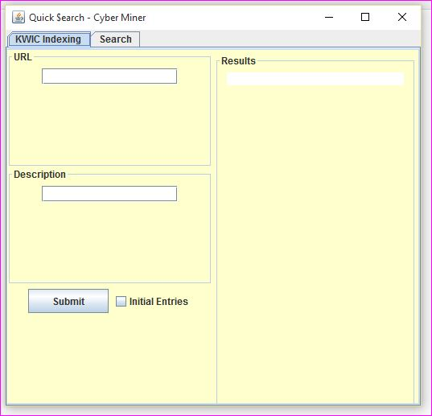
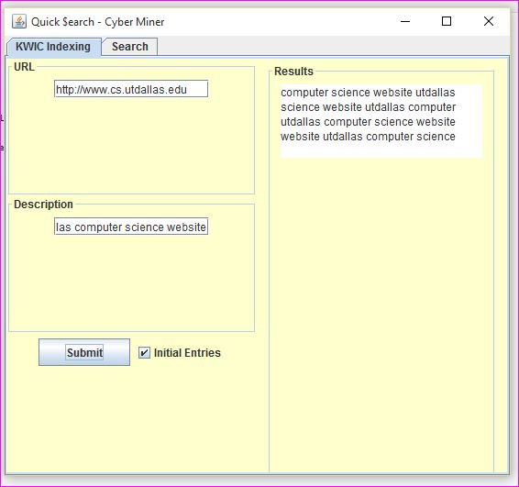
IMPLEMENTATION

Slide 19
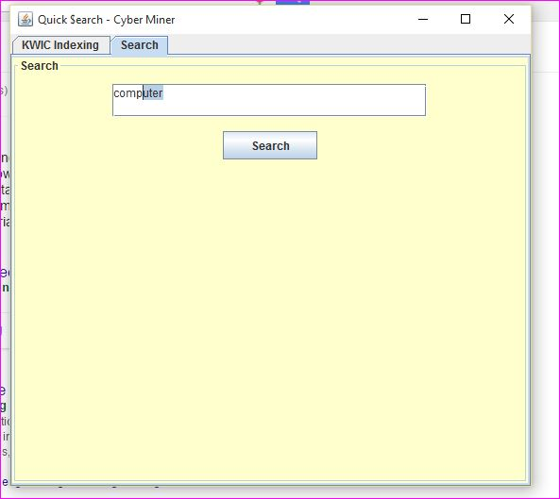
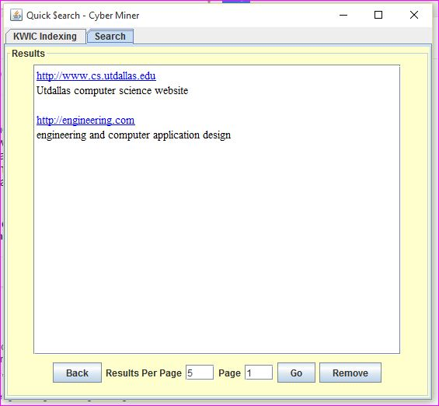
IMPLEMENTATION

Slide 20
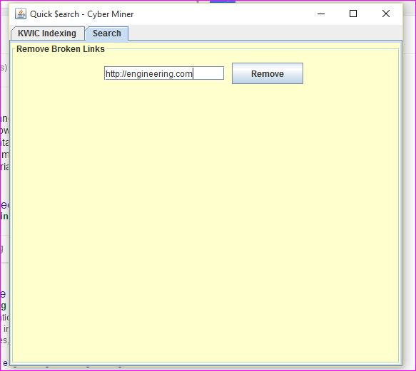
IMPLEMENTATION

Slide 21
REFERENCES
Dr. Lawrence Chung
Professor - CS/SE 6362 Advanced Software Architecture & Design – Fall 2015
Textbook
Mary Shaw & David Garlan. Software Architecture: Perspectives on an Emerging Discipline

Slide 22

QUESTIONS

